Slide 1

CHAPTER 4
ELEMENTARY
NUMBER THEORY
AND METHODS
OF PROOF
Copyright © Cengage Learning. All rights reserved.

Slide 2
SECTION 4.2
Direct Proof and Counterexample II: Rational Numbers
Copyright © Cengage Learning. All rights reserved.

Slide 3
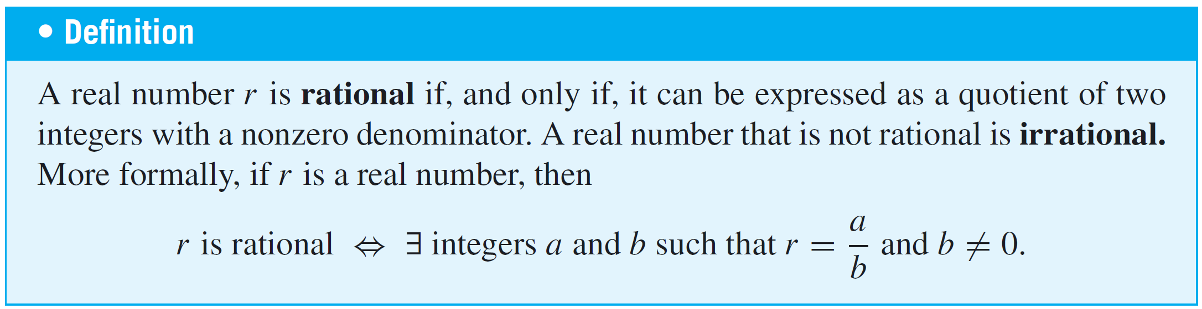
Direct Proof and Counterexample II: Rational Numbers
Sums, differences, and products of integers are integers. But most quotients of integers are not integers. Quotients of integers are, however, important; they are known as rational numbers.
The word rational contains the word ratio, which is another word for quotient. A rational number can be written as a ratio of integers.

Slide 4
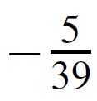
Example 1 – Determining Whether Numbers Are Rational or Irrational
a. Is 10/3 a rational number?
b. Is a rational number?
c. Is 0.281 a rational number?
d. Is 7 a rational number?
e. Is 0 a rational number?

Slide 5
Example 1 – Determining Whether Numbers Are Rational or Irrational
cont’d
f. Is 2/0 a rational number?
g. Is 2/0 an irrational number?
h. Is 0.12121212 . . . a rational number (where the digits 12
are assumed to repeat forever)?
i. If m and n are integers and neither m nor n is zero, is
(m + n) /m n a rational number?

Slide 6
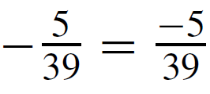
Example 1 – Solution
a. Yes, 10/3 is a quotient of the integers 10 and 3 and
hence is rational.
b. Yes, , which is a quotient of the integers −5 and
39 and hence is rational.
c. Yes, 0.281 = 281/1000. Note that the real numbers represented on a typical calculator display are all finite decimals.
An explanation similar to the one in this example shows that any such number is rational. It follows that a calculator with such a display can represent only rational numbers.

Slide 7
Example 1 – Solution
cont’d
d. Yes, 7 = 7/1.
e. Yes, 0 = 0/1.
f. No, 2/0 is not a number (division by 0 is not allowed).
g. No, because every irrational number is a number, and
2/0 is not a number.

Slide 8
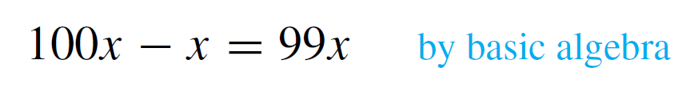
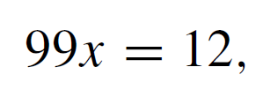
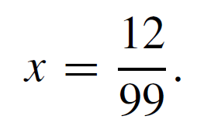
Example 1 – Solution
cont’d
h. Yes. Let Then
Thus
But also
Hence
And so
Therefore, 0.12121212…. = 12/99, which is a ratio of
two nonzero integers and thus is a rational number.

Slide 9
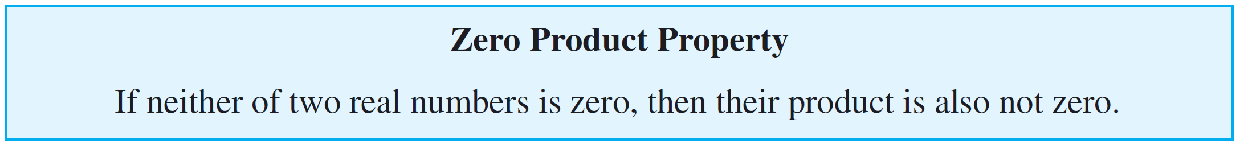
Example 1 – Solution
cont’d
Note that you can use an argument similar to this one to
show that any repeating decimal is a rational number.
i. Yes, since m and n are integers, so are m + n and m n
(because sums and products of integers are integers).
Also m n ≠ 0 by the zero product property.
One version of this property says the following:

Slide 10
Example 1 – Solution
cont’d
It follows that (m + n) /m n is a quotient of two integers with a nonzero denominator and hence is a rational number.

Slide 11
More on Generalizing from the Generic Particular

Slide 12
More on Generalizing from the Generic Particular
Some people like to think of the method of generalizing from the generic particular as a challenge process.
If you claim a property holds for all elements in a domain, then someone can challenge your claim by picking any element in the domain whatsoever and asking you to prove that that element satisfies the property.
To prove your claim, you must be able to meet all such challenges. That is, you must have a way to convince the challenger that the property is true for an arbitrarily chosen element in the domain.

Slide 13
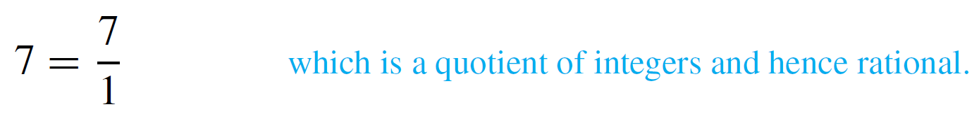
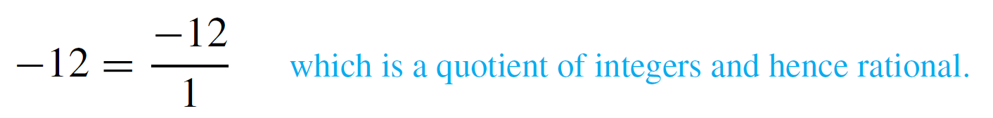
More on Generalizing from the Generic Particular
For example, suppose “A” claims that every integer is a rational number. “B” challenges this claim by asking “A” to prove it for n = 7.
“A” observes that
“B” accepts this explanation but challenges again with n = –12. “A” responds that

Slide 14
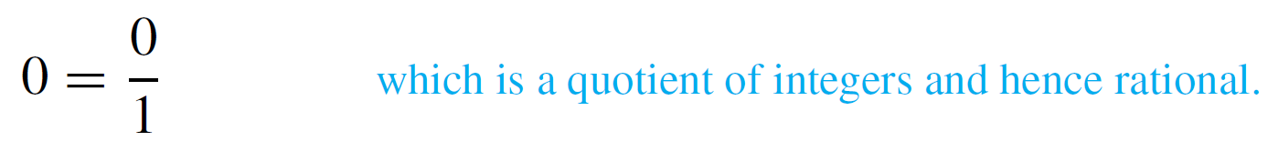
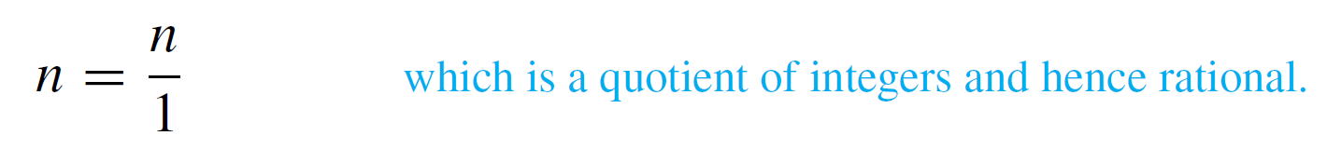
More on Generalizing from the Generic Particular
Next “B” tries to trip up “A” by challenging with n = 0, but “A” answers that
As you can see, “A” is able to respond effectively to all “B”s challenges because “A” has a general procedure for putting integers into the form of rational numbers: “A” just divides whatever integer “B” gives by 1.
That is, no matter what integer n “B” gives “A”, “A” writes

Slide 15
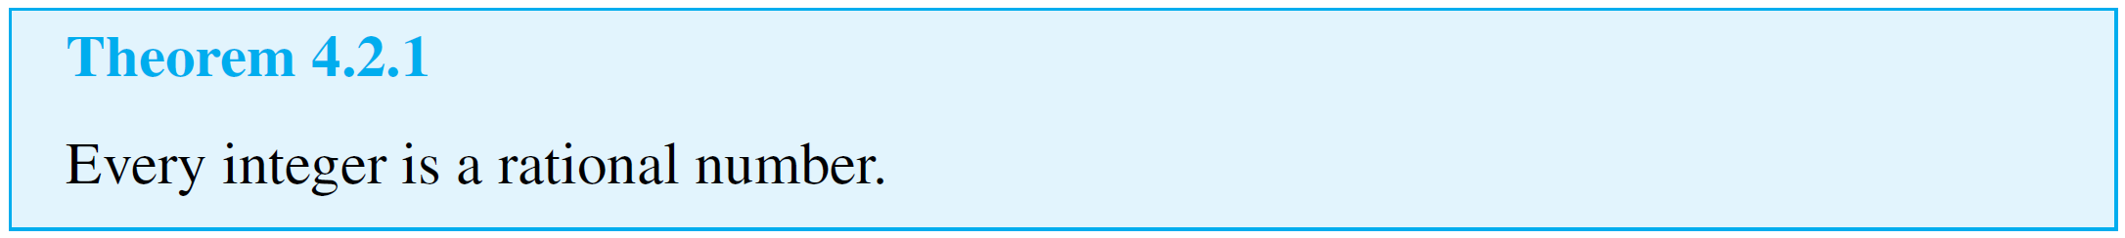
More on Generalizing from the Generic Particular
This discussion proves the following theorem.

Slide 16
Proving Properties of Rational Numbers

Slide 17
Proving Properties of Rational Numbers
The next example shows how to use the method of generalizing from the generic particular to prove a property of rational numbers.

Slide 18
Example 2 – A Sum of Rationals Is Rational
Prove that the sum of any two rational numbers is rational.
Solution:
Begin by mentally or explicitly rewriting the statement to be proved in the form “∀______, if ______ then ______.”
Formal Restatement: ∀ real numbers r and s, if r and s
are rational then r + s is rational.
Next ask yourself, “Where am I starting from?” or “What am I supposing?” The answer gives you the starting point, or first sentence, of the proof.

Slide 19
Example 2 – Solution
cont’d
Starting Point: Suppose r and s are particular but arbitrarily
chosen real numbers such that r and s are
rational; or, more simply, Suppose r and s
are rational numbers.
Then ask yourself, “What must I show to complete the proof?”
To Show: r + s is rational.
Finally ask, “How do I get from the starting point to the conclusion?” or “Why must r + s be rational if both r and s are rational?” The answer depends in an essential way on the definition of rational.

Slide 20
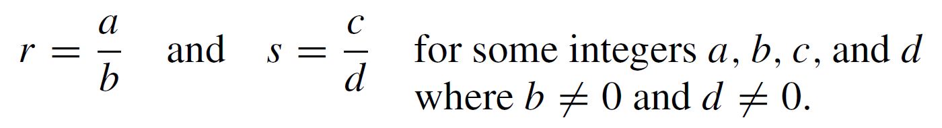
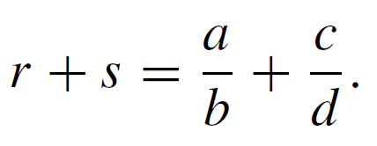
Example 2 – Solution
cont’d
Rational numbers are quotients of integers, so to say that r and s are rational means that
It follows by substitution that

Slide 21
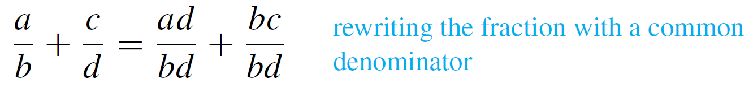
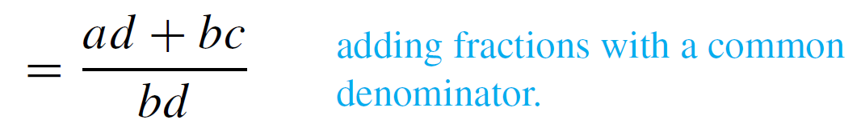
Example 2 – Solution
cont’d
You need to show that r + s is rational, which means that r + s can be written as a single fraction or ratio of two integers with a nonzero denominator.
But the right-hand side of equation (4.2.1) in

Slide 22
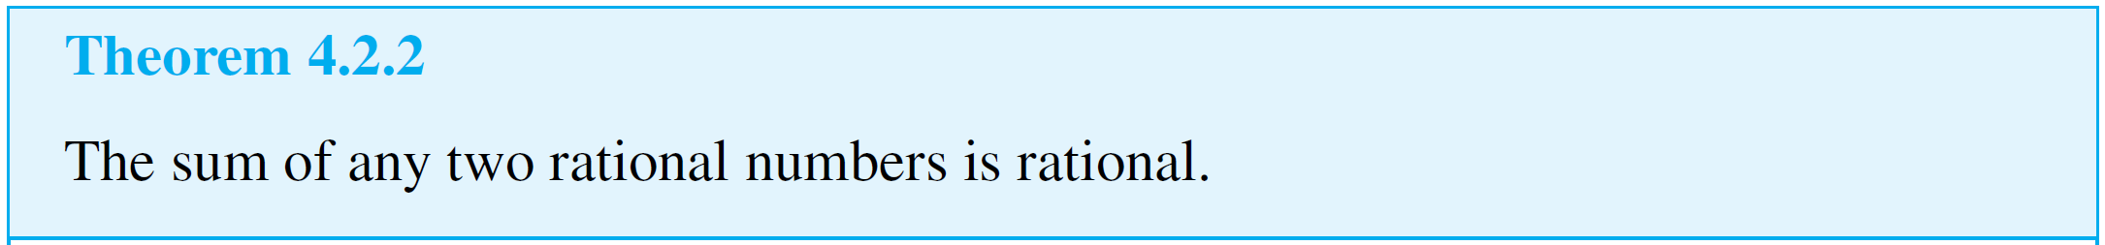
Example 2 – Solution
cont’d
Is this fraction a ratio of integers? Yes. Because products and sums of integers are integers, ad + bc and bd are both integers.
Is the denominator bd ≠ 0? Yes, by the zero product property (since b ≠ 0 and d ≠ 0). Thus r + s is a rational number.
This discussion is summarized as follows:

Slide 23
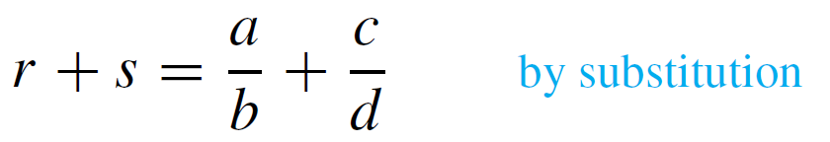
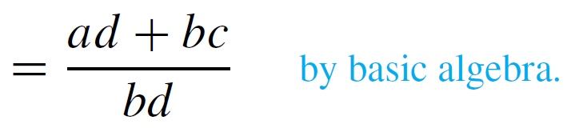
Example 2 – Solution
cont’d
Proof:
Suppose r and s are rational numbers. [We must show that r + s is rational.]
Then, by definition of rational, r = a/b and s = c/d for some integers a, b, c, and d with b ≠ 0 and d ≠ 0.
Thus

Slide 24
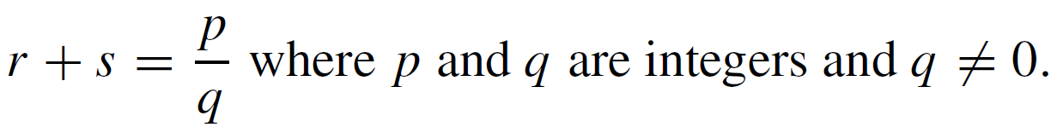
Example 2 – Solution
cont’d
Let p = ad + bc and q = bd. Then p and q are integers because products and sums of integers are integers and because a, b, c, and d are all integers.
Also q ≠ 0 by the zero product property.
Thus
Therefore, r + s is rational by definition of a rational number. [This is what was to be shown.]

Slide 25
Deriving New Mathematics from Old

Slide 26
Deriving New Mathematics from Old
In the future, when we ask you to prove something directly from the definitions, we will mean that you should restrict yourself to this approach.
However, once a collection of statements has been proved directly from the definitions, another method of proof becomes possible.
The statements in the collection can be used to derive additional results.

Slide 27
Example 3 – Deriving Additional Results about Even and Odd Integers
Suppose that you have already proved the following properties of even and odd integers:
1. The sum, product, and difference of any two even integers
are even.
2. The sum and difference of any two odd integers are even.
3. The product of any two odd integers is odd.
4. The product of any even integer and any odd integer is
even.

Slide 28
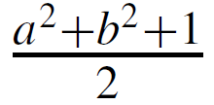
Example 3 – Deriving Additional Results about Even and Odd Integers
cont’d
5. The sum of any odd integer and any even integer is odd.
6. The difference of any odd integer minus any even
integer is odd.
7. The difference of any even integer minus any odd
integer is odd.
Use the properties listed above to prove that if a is any
even integer and b is any odd integer, then is an integer.

Slide 29


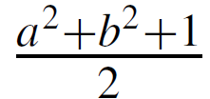
Example 3 – Solution
Suppose a is any even integer and b is any odd integer. By property 3, b² is odd, and by property 1, a² is even.
Then by property 5, a² + b² is odd, and because 1 is also odd, the sum is even by property 2.
Hence, by definition of even, there exists an integer k such that
Dividing both sides by 2 gives = k, which is an integer.
Thus is an integer [as was to be shown].

Slide 30
Deriving New Mathematics from Old
A corollary is a statement whose truth can be immediately deduced from a theorem that has already been proved.

Slide 31
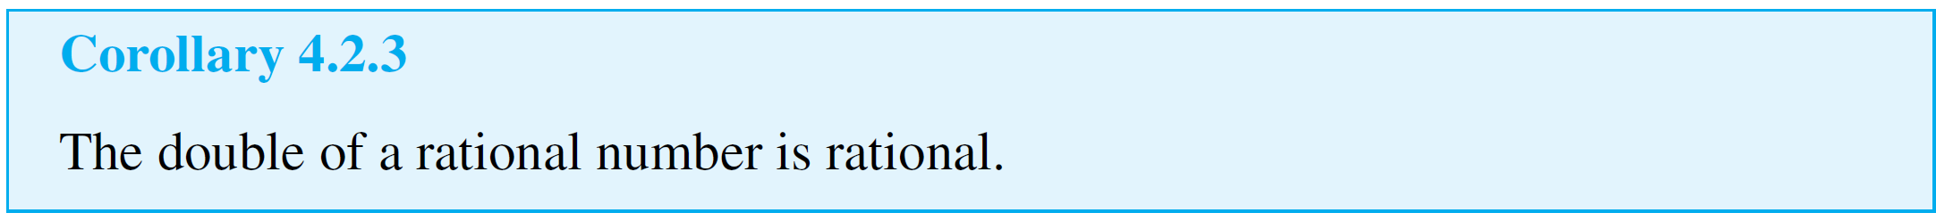
Example 4 – The Double of a Rational Number
Derive the following as a corollary of Theorem 4.2.2.
Solution:
The double of a number is just its sum with itself.
But since the sum of any two rational numbers is rational (Theorem 4.2.2), the sum of a rational number with itself is rational.
Hence the double of a rational number is rational.

Slide 32
Example 4 – Solution
cont’d
Here is a formal version of this argument:
Proof:
Suppose r is any rational number. Then 2r = r + r is a sum of two rational numbers.
So, by Theorem 4.2.2, 2r is rational.

